Slide 1

Introduction To Cryptography
The privacy and integrity matters !
Gautam Suraj CSE AI 7th Roll No. 42

Slide 2
Contents
Cryptography
Objectives
Ciphers
Encryption Decryption
Types of Cryptography
Techniques of Encryption Decryption
Algorithms
Applications
Closure

Slide 3

Cryptography
What is Cryptography ? Cryptography derived it’s name from a Greek word “Kryptos” which means “Hidden Secrets”. It is the science of converting a plain intelligible data into unintelligible data and again transform that message into its original form. It provides confidentiality, integrity and accuracy.

Slide 4

Objectives
Confidentiality
Prevents unauthorized parties from accessing data or understanding information intended for a specific recipient.
Integrity
Ensures that information is not altered during storage or transmission.
Authentication
Verifies the identity of the sender and receiver, and the origin and destination of the information.
Non-repudiation
Ensures that the creator or sender of the information cannot deny their intentions later on.

Slide 5
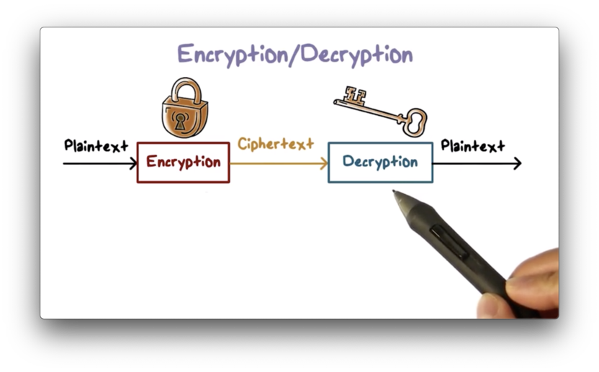
Ciphers
A cipher is a mathematical algorithm used in cryptography to encrypt or decrypt data
The plaintext that gets converted into unreadable code is called Ciphertext

Slide 6
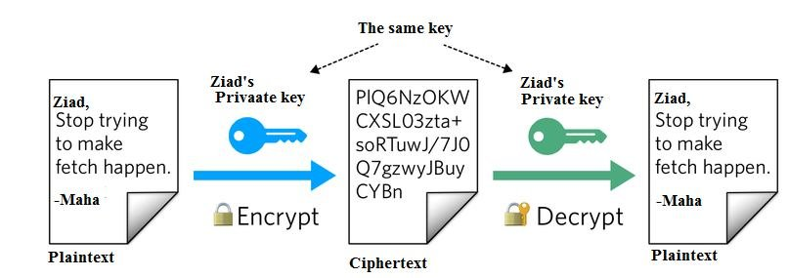
Encryption Decryption
Encryption : It is a process that scrambles data using mathematical models to make it unreadable to anyone without the correct key or password
Decryption : The conversion of encrypted data into its original form is called Decryption. It is generally a reverse process of encryption.

Slide 7
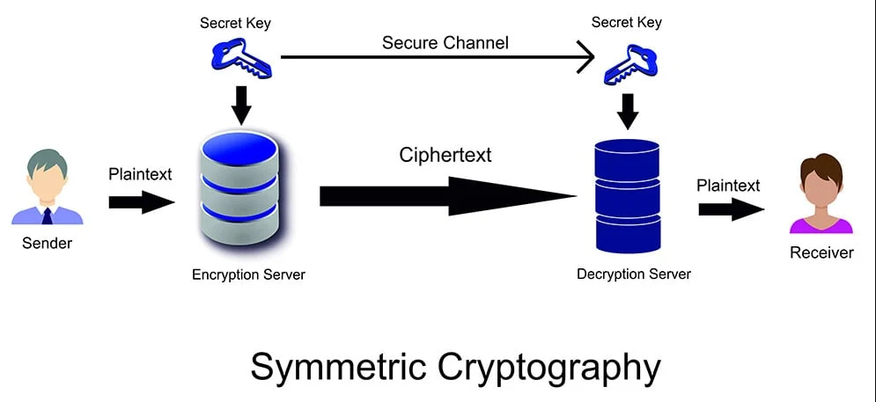
Types of Cryptography
Symmetric Key Cryptography It uses same key in both side for encrypting and decrypting data. Advantage : Simple and Faster Disadvantage : Less Secured

Slide 8
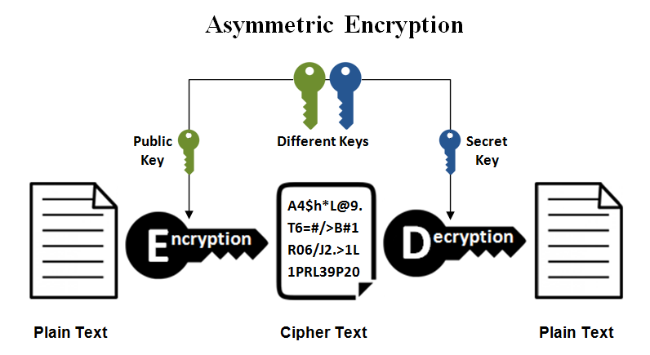
Types of Cryptography
Asymmetric Key Cryptography Two different keys are used and the user gets the key from a Certified Authority. Advantages : More secured, Authentication. Disadvantages : Relatively complex.

Slide 9

Techniques of Encryption and Decryption
Key : A key is a group of random characters in a particular order. Encryption protocols use a key to alter data so that it's scrambled, and so that anyone without the key can't decode the information. Block Cipher : A method of encrypting / decrypting data. A cryptographic algorithm that encrypts data in fixed-size blocks using a key and algorithm Stream Cipher : It is a type of encryption that transforms plain text into code that's unreadable without the correct key

Slide 10
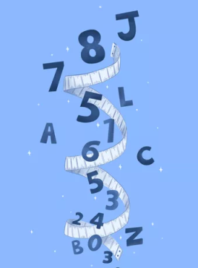
Algorithms
DES : The full form of DES is Data Encryption Standard. DES is a cryptographic symmetric-key algorithm that encrypts digital data. Even though the short key length (56 bits) makes DES too insecure for any application- it is still very influential in advancing cryptography.
AES : AES – Advanced Encryption Standards uses symmetric keys to encrypt and decrypt data, so it's faster, but the encryption key must be shared securely. The used key sizes are 128, 192, and 256 bits. Overall, AES is much faster and more efficient, particularly for encrypting large data.
Hashing : In cryptography, hashing is a one-way mathematical process that converts data into a unique string of characters, called a hash value, that can't be reversed or decoded.

Slide 11
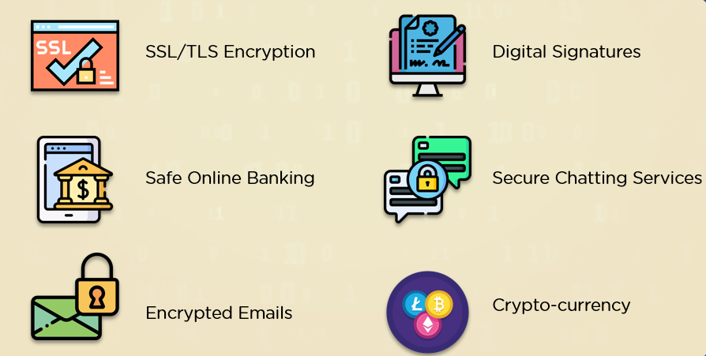
Applications of Cryptography

Slide 12
Closure
Cryptography is important in the present time because it helps protect sensitive information, maintain data integrity, and verify identities. With a loads of information flowing through the internet, it is our responsibility to keep our data safe from other’s eyes. Thank You ! References : Simplilearn, Slideshare, Geeksforgeeks.

